Slide 1
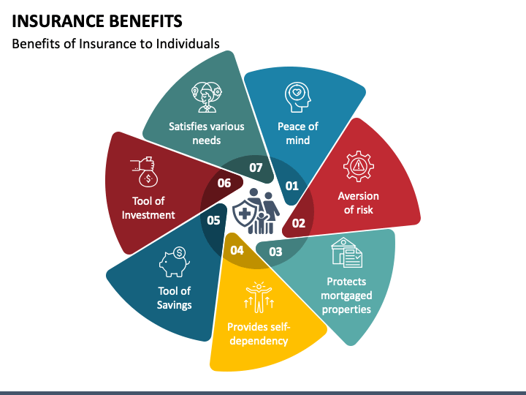
Title: Medical Insurance Claim Prediction.
By:- Kaushal Bachhav
Imarticus PGA - 44

Slide 2
Objective:- Optimize premium rates based on the predicted claim probabilities..

Slide 3
Why Make claim Prediction Model.
With the help of insights Insurance companies can make informed business decisions. This includes setting premium rates, optimizing resource allocation, and developing strategies to improve customer satisfaction and retention.

Slide 4
1
2
3
4
5
6
Data Ingestion
Data Preprocessing
Data Clustering
Train Test Split for each cluster
Model selection for each cluster
Save model and Predict
Project Architecture: A Streamlined Workflow
A description of the process view of the architecture. Describes the tasks (processes) involved in the system's execution, from data ingestion to model selection and tuning, ensuring a robust and efficient system for Medical Insurance Data.

Slide 5







Tools Used:
Tools : Python
Platform : Jupyter Notebook, Visual Studio Code
LibraryUsed : Numpy, Pandas, matplotlib, seaborn, Scikit-learn

Slide 6
Dataset Description: Exploratory Analysis of Medical Insurance Data The provided dataset encompasses a comprehensive collection of information related to individuals and their corresponding medical insurance charges. The dataset is designed to facilitate an in-depth exploration of the factors influencing healthcare costs, providing valuable insights for stakeholders within the healthcare industry, insurance providers, and policymakers.
Age:
Represents the age of each individual in years.
Gender:
Indicates the gender of the individuals, categorized as male or female.
BMI (Body Mass Index):
Quantifies the body mass of individuals, serving as an indicator of body fat.
Children:
Enumerates the number of children or dependents covered by the insurance.
Smoking Status:
Identifies whether an individual is a smoker or a non-smoker.
Region:
Specifies the geographical region where the individual resides.
Insurance Charges:
The primary variable of interest, representing the medical insurance charges incurred by each individual.

Slide 7
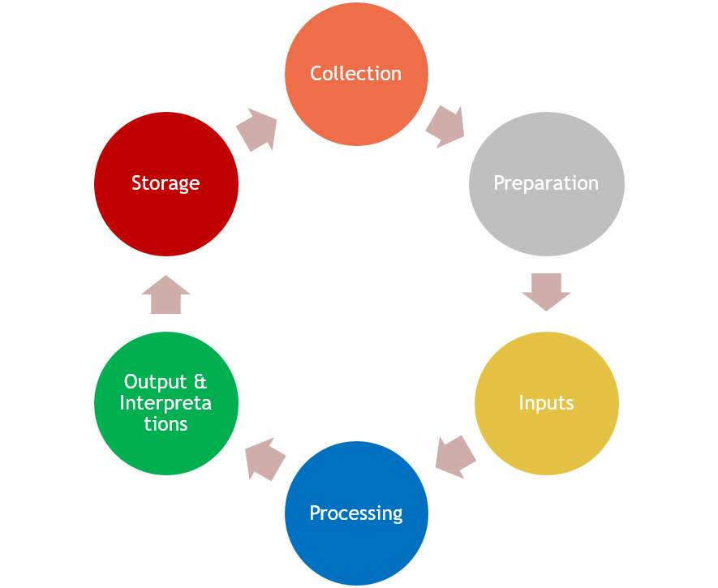
Data Ingestion: Quality Assurance for Accurate Results
Validating the Data which is been Ingested from the source:
After validating the proper structure and Expectations for the data
further process of Data Preprocessing is started.
.

Slide 8
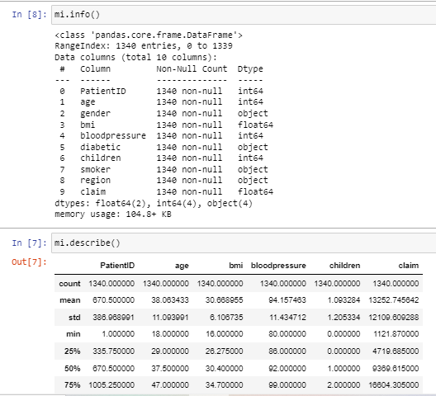
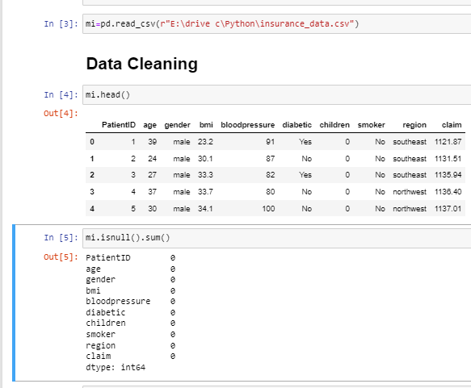
Data Preprocessing: Feature Engineering
When you use the info() method on a Pandas Data Frame in Python, you get information about the
Data Frame, including the data types, non-null counts, and memory usage. Here's what each part of the output
typically tells us.

Slide 9
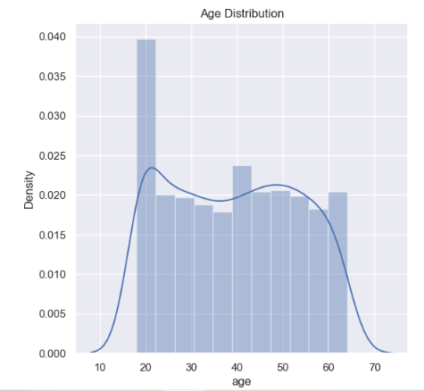
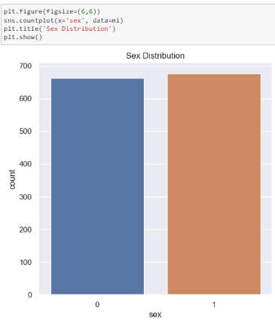
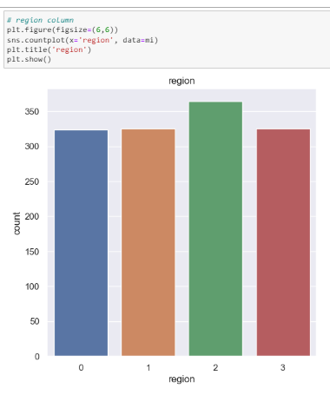
Data Visualisation:-

Slide 10
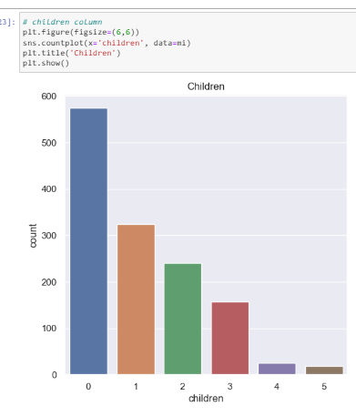
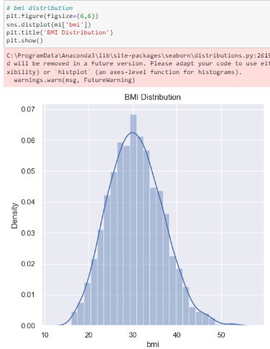
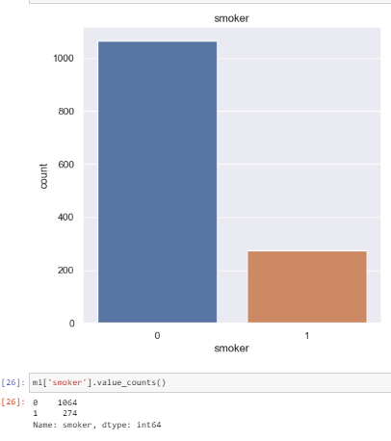

Slide 11
Model Selection :-
Algorithm | Rsquare (Train data) | MSE(Test Data)
LinearRegression | 0.87 | 19585808.37
DecisionTreeRegressor | 1.0 | 16831.89
RandomForestRegressor | 0.999 | 7729.14

Slide 12
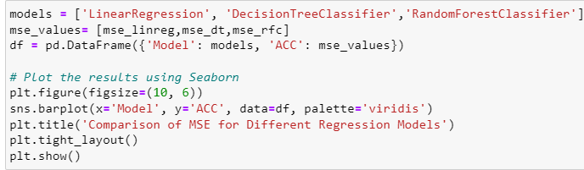
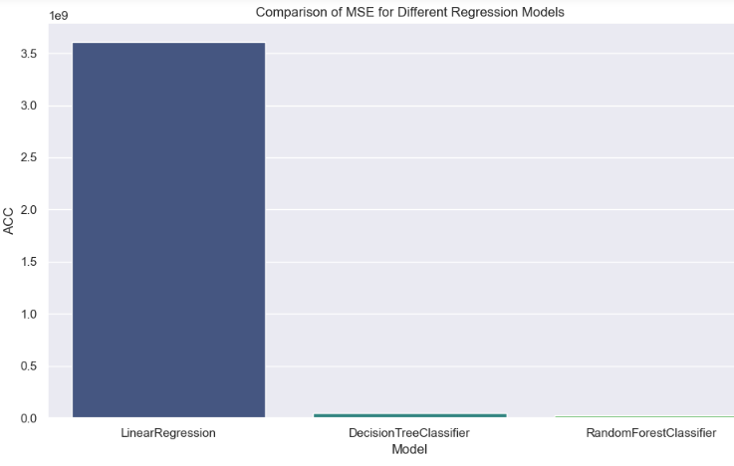
Comparison Of MSE for Different Regression Models

Slide 13
Pridiction :-It seems like there might be a small typo in your question. I assume you meant "prediction." A prediction is an estimate or forecast about a future outcome based on available information or historical data. In the context of machine learning and statistics, making predictions involves using a model to infer the value of a target variable given the values of one or more predictor variables.
R-squared :- (R²), also known as the coefficient of determination, is a statistical measure that represents the proportion of the variance in the dependent variable that is explained by the independent variables in a regression model. In simpler terms, R-squared quantifies the goodness of fit of a regression model to the observed data.
Mean Squared Error :- (MSE) is a common metric used to evaluate the performance of a regression model. It measures the average squared difference between the actual and predicted values. The lower the MSE, the better the model is at making accurate predictions.

Slide 14
Cluclusion –
Lower the MSE Better is the model
In this Medical insurance Data Random Forest Classifier is performing Best.
Adjust premium rates for different policyholders to reflect their risk profiles, ensuring fairness and competitiveness.
References:
Data source: https://archive.ics.uci.edu/
Preprocessing: https://pypi.org/project/imbalanced-learn/
Google.com for images

